Slide 1






KONGU ENGINEERING COLLEGE
PERUNDURAI ERODE-638060
DEPARTMENT OF COMPUTER TECHONOLOGY-UG
TITLE : Online Platform For Dessert
Products
Team Members:
Angappan N(22BIR003) Gokula Shankar T.K(22BIR011)
Pavish K(22BIR036)
Guided By:
Dr.A.Muthusamy
`
In association with:

Slide 2
ABSTRACT
The Online Platform for Dessert Products simplifies ordering by allowing bulk orders for customers. It features an easy interface to browse, check availability, and place orders.
Customers can view detailed product information, explore special offers, and enjoy secure online payments. Real-time order tracking, inventory management, and customer support ensure a smooth experience.
Built with Angular, MongoDB, Express, and Node, the platform offers fast, secure, and scalable performance. It helps the bakery expand its business and reach more customers in the digital world.

Slide 3


EXISTING SYSTEM
Local bakeries rely on manual order management, with orders taken in person, via phone, or WhatsApp. Bulk orders are tracked manually, leading to inefficiencies and mismanagement.
Inventory tracking is done manually or in spreadsheets, making stock management difficult. There are no real-time updates, leading to wastage or shortages.
Customer engagement is minimal, with no online platform for browsing or ordering. Marketing depends on word-of-mouth and social media, with no order tracking for customers.
19-Mar-25

Slide 4
PROBLEM DEFINITION
Inefficient Order Management: Orders are manually taken in person, via phone, leading to errors, inefficiencies, and challenges in tracking bulk orders.
Manual Inventory Tracking: Inventory is tracked manually or with spreadsheets, causing stock mismanagement, shortages, and wastage due to the lack of real-time updates.
Limited Customer Engagement & Marketing: There is no online platform for browsing or ordering, and marketing is dependent on word-of-mouth and social media, limiting customer reach and interaction.
19-Mar-25

Slide 5
FEASIBILITY STUDY
The project is technically feasible using the MEAN stack, ensuring scalability and smooth integration of payment gateways and order tracking.
The system’s initial development cost is offset by the long-term benefits of improved efficiency, reduced wastage, and increased customer reach. The operational savings make it financially viable.
The platform will be easy to use for bakery staff and customers, improving order management and inventory control. The online system also allows for better customer engagement and business growth.
19-Mar-25

Slide 6
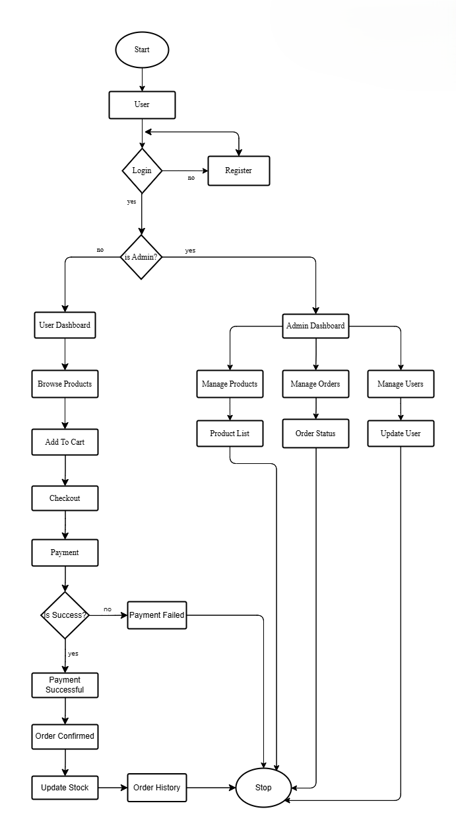
SYSTEM FLOW DIAGRAM
19-Mar-25

Slide 7
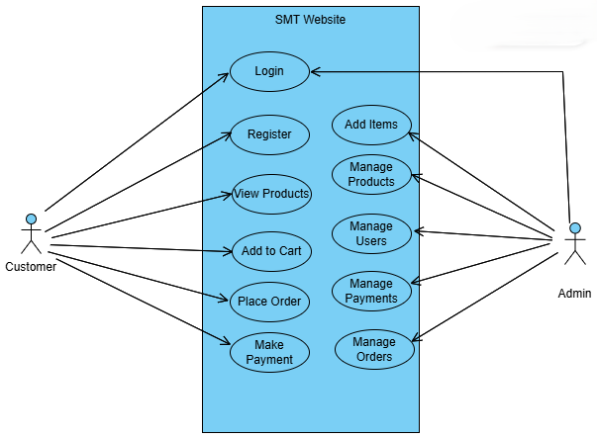
USECASE DIAGRAM
19-Mar-25

Slide 8
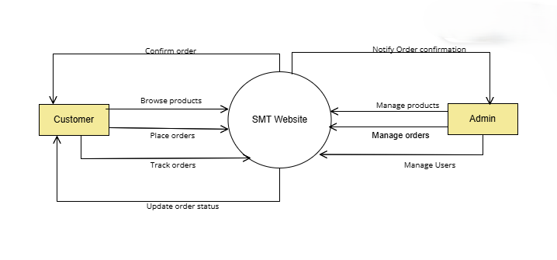
DATA FLOW DIAGRAM LV0
19-Mar-25

Slide 9
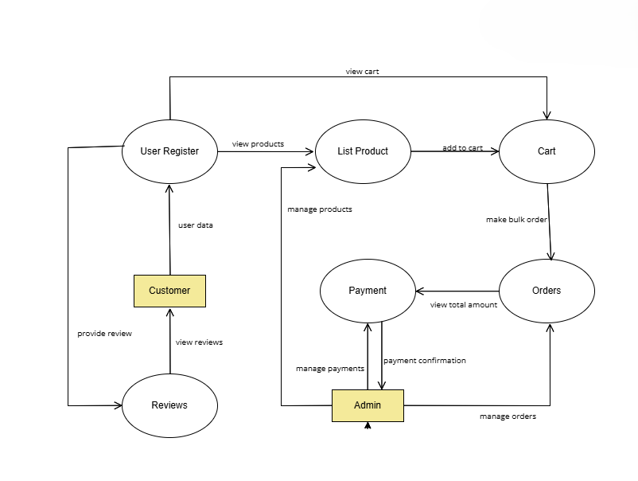
DATA FLOW DIAGRAM LV1
19-Mar-25

Slide 10
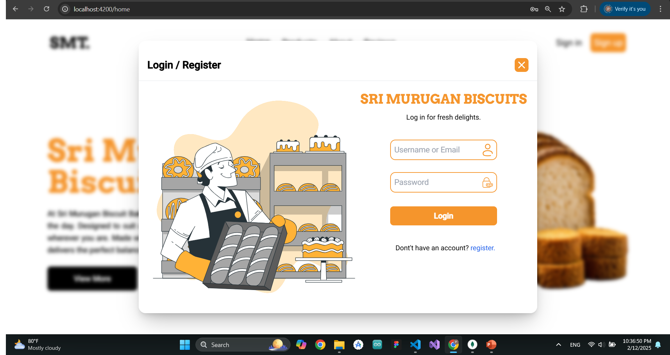
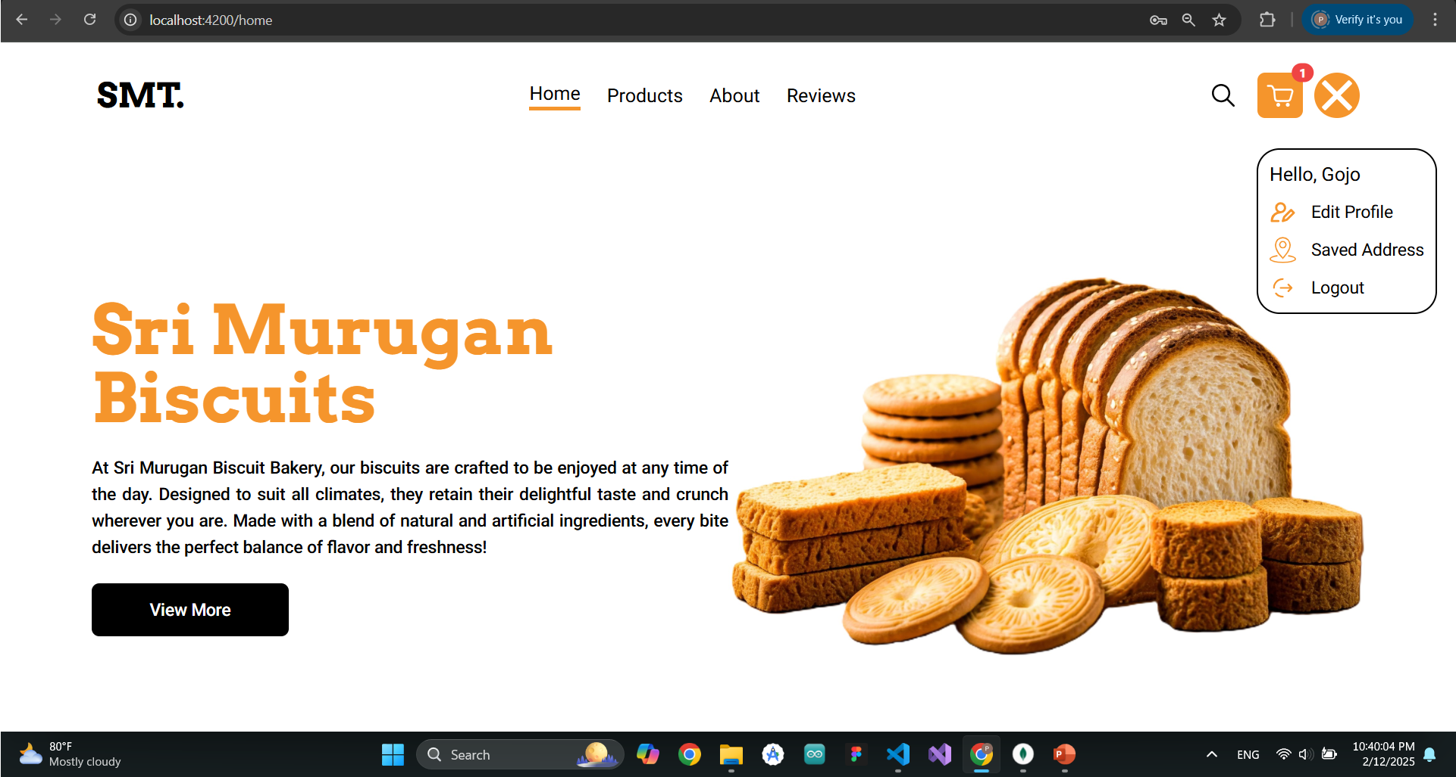
USER INTERFACE DESIGN
User management module
19-Mar-25

Slide 11
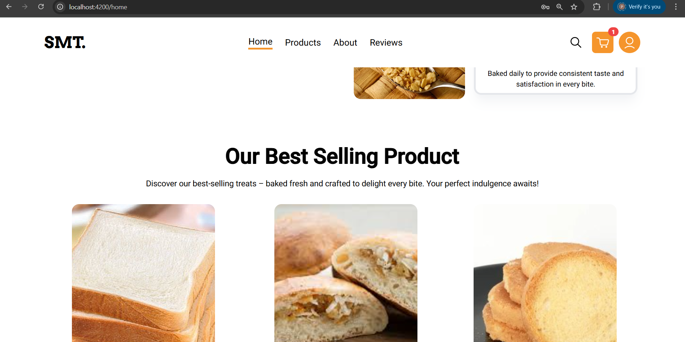
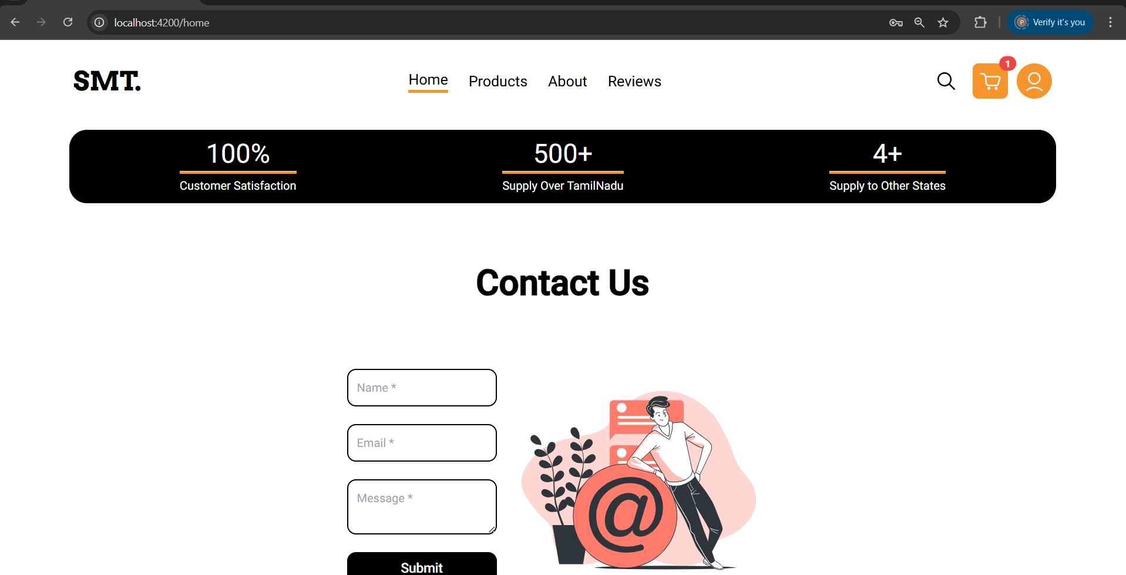
USER INTERFACE DESIGN
Home module
19-Mar-25

Slide 12
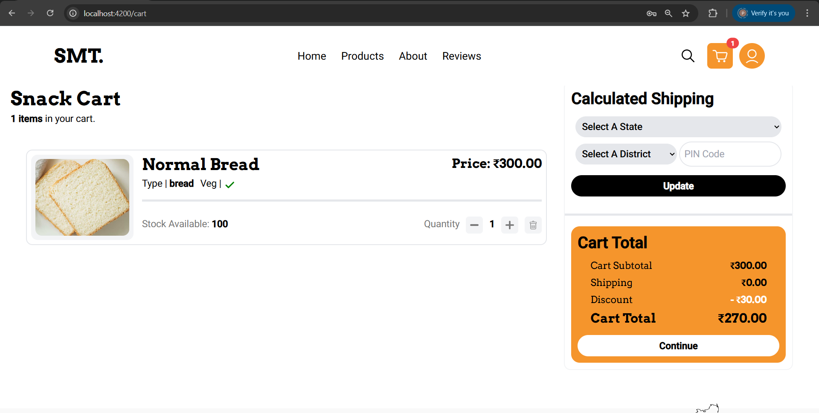
USER INTERFACE DESIGN
Cart module
19-Mar-25

Slide 13
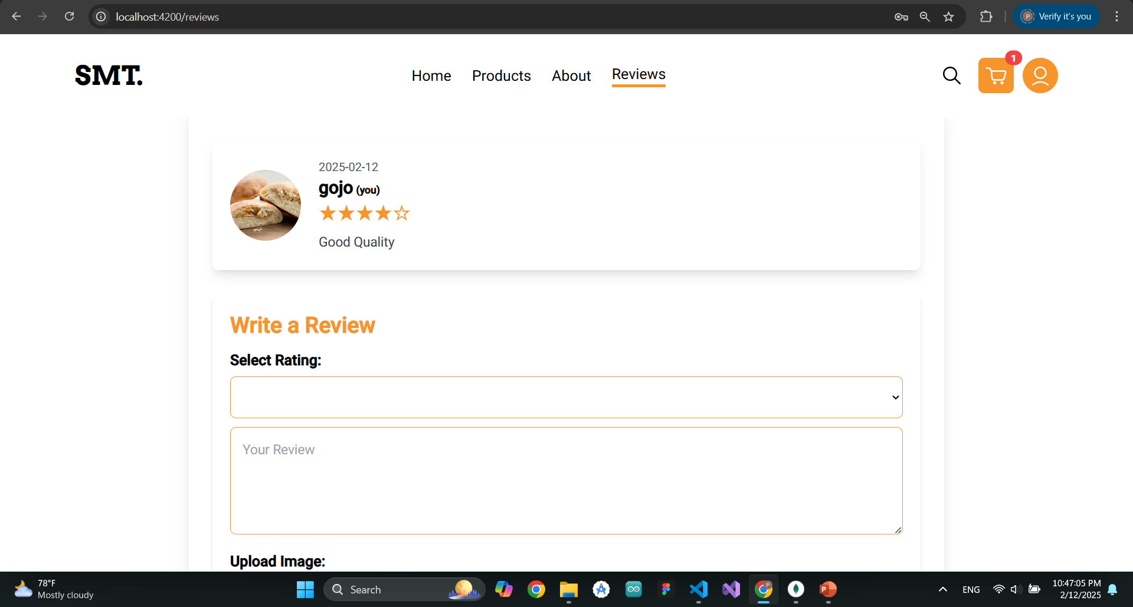
USER INTERFACE DESIGN
Review module
19-Mar-25

Slide 14
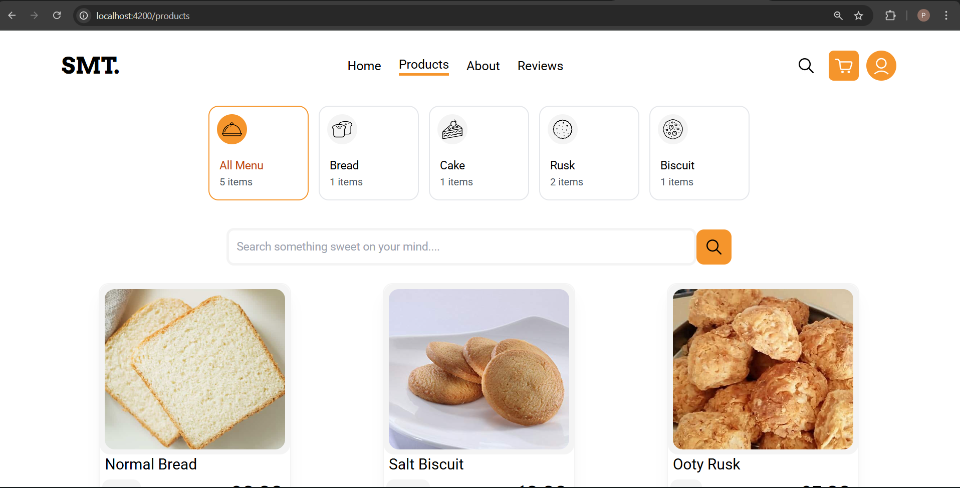
USER INTERFACE DESIGN
Product module
19-Mar-25

Slide 15
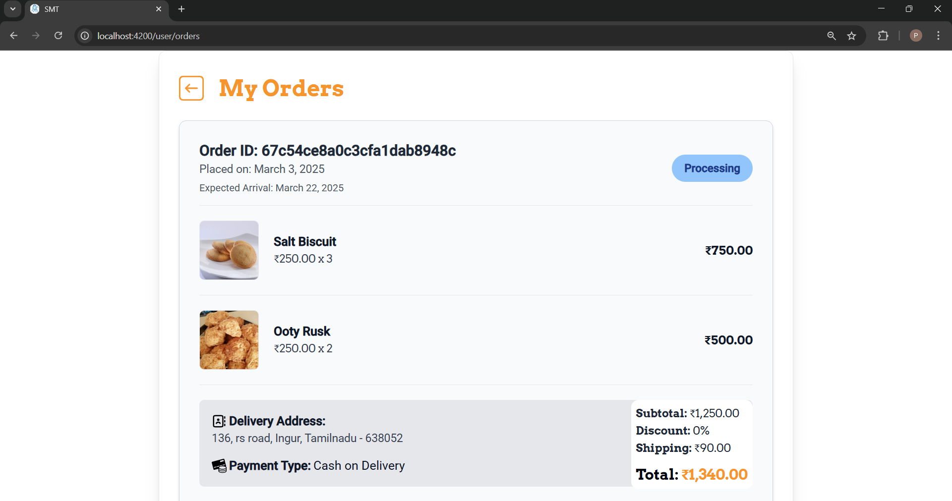
USER INTERFACE DESIGN
Order module
19-Mar-25

Slide 16
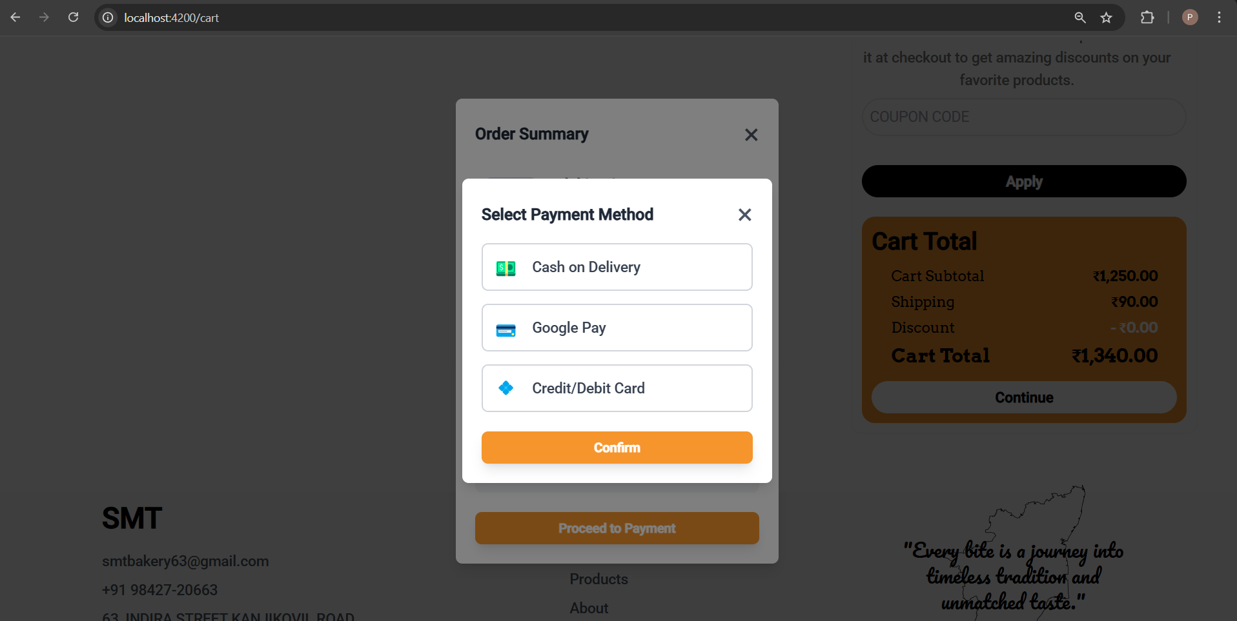
USER INTERFACE DESIGN
Payment module
19-Mar-25

Slide 17
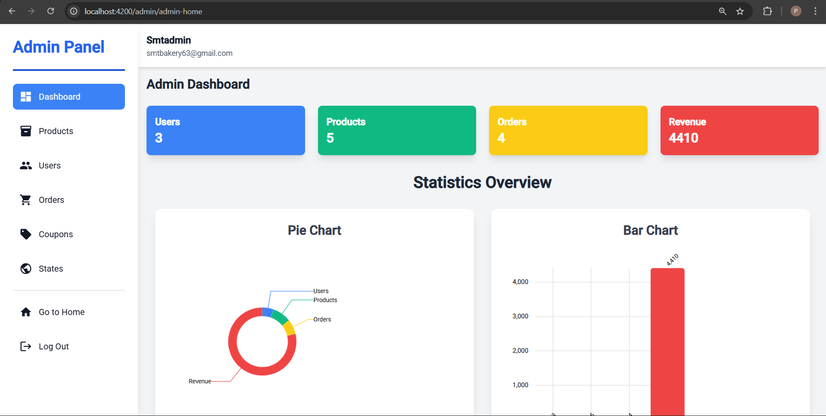
USER INTERFACE DESIGN
Admin module
19-Mar-25

Slide 18
CONCLUSION
In conclusion, developing a digital platform for the bakery is both technically and economically feasible, offering significant improvements in order management, inventory tracking, and customer engagement. By automating processes and providing an online ordering system, the bakery can reduce operational costs, minimize wastage, and expand its customer base. The user-friendly system will enhance customer experience and streamline operations, positioning the bakery for long-term growth and success in the competitive market.
19-Mar-25

Slide 19
FUTURE WORK
New Product Notification: Customers will receive email notifications about new product launches and special offers to keep them updated and engaged.
Discount and Offer Updates: Regular updates on discounts, seasonal offers, and exclusive deals to encourage repeat purchases.
Wishlist Feature: Allow customers to create a wishlist of their favorite products for easy future access and quick ordering.
19-Mar-25

Slide 20
THANKYOU!

